Slide 1

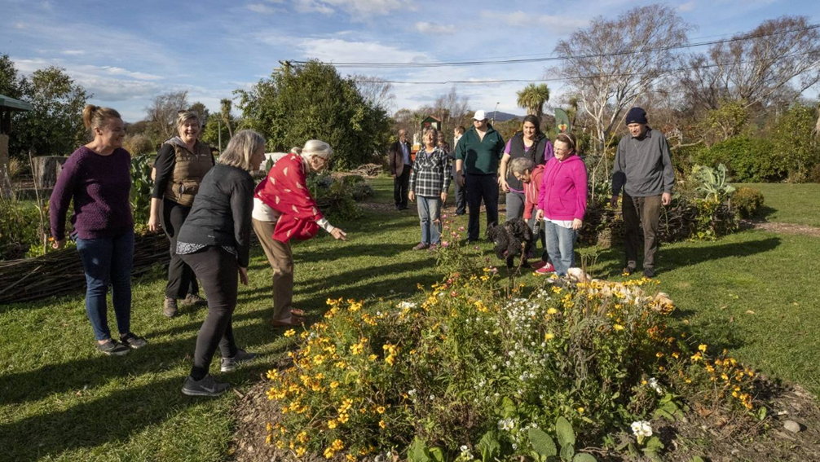

Canterbury Community Gardens Association AGM
Emily Major
Roots & Shoots Coordinator
Canterbury, New Zealand
Email: e.major@janegoodall.org.nz

Slide 2
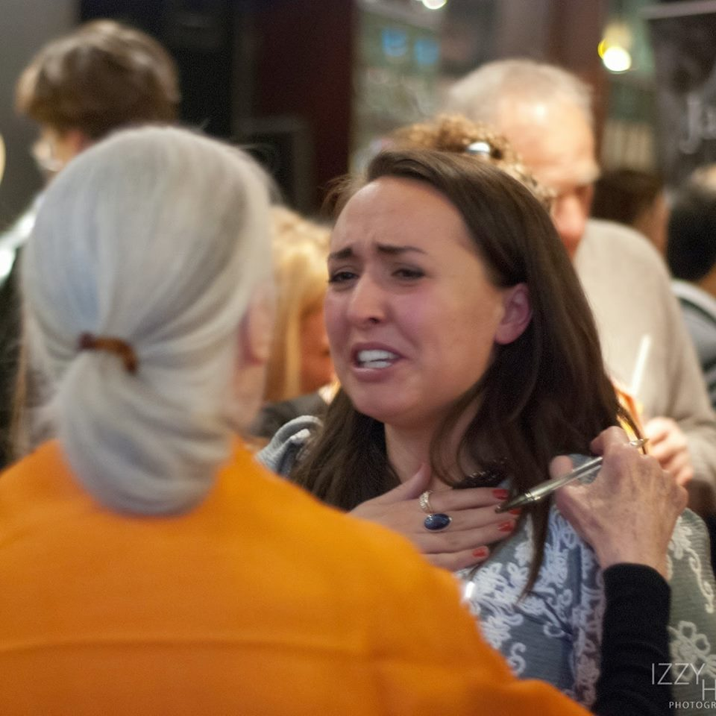


Roots creep underground everywhere and make a firm foundation. Shoots seem very weak, but to reach the light, they can break open brick walls. Imagine that the brick walls are all the problems we have inflicted on our planet. Hundreds of thousands of roots and shoots, hundreds of thousands of young people around the world, can break through these walls.
Dr. Jane Goodall

Slide 3
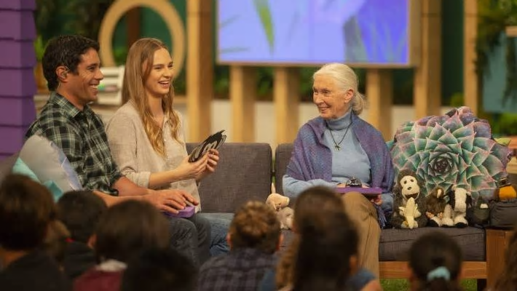
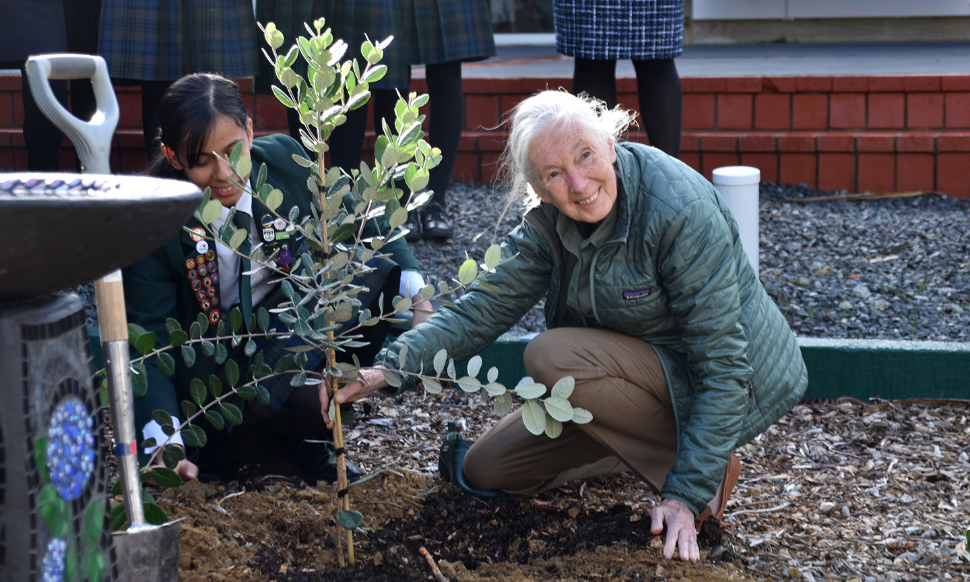


Slide 4
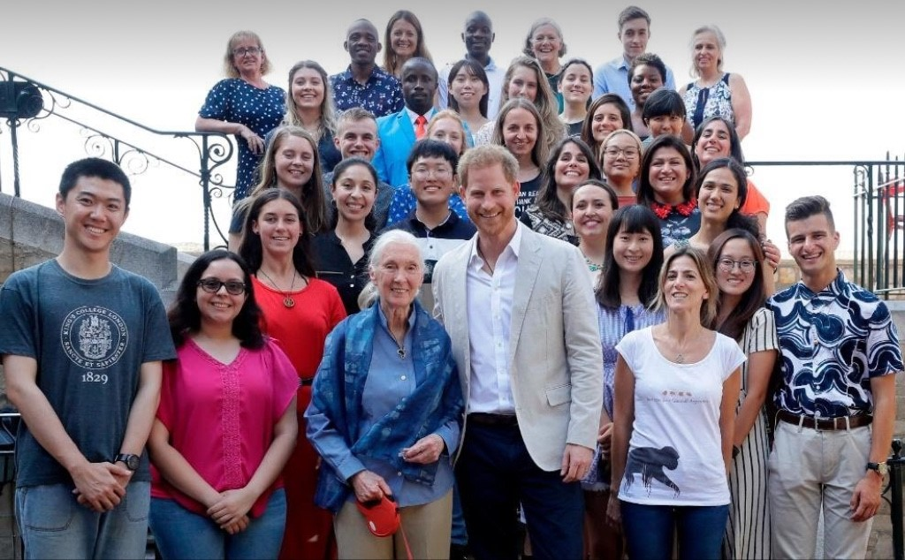
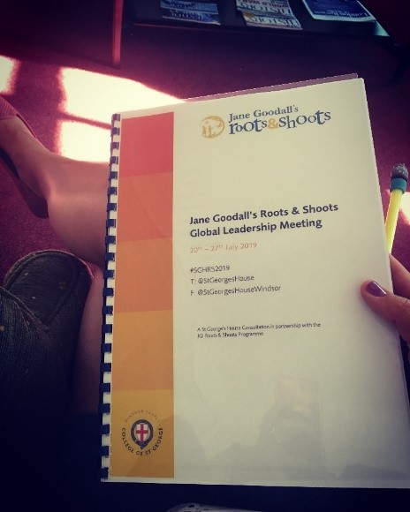
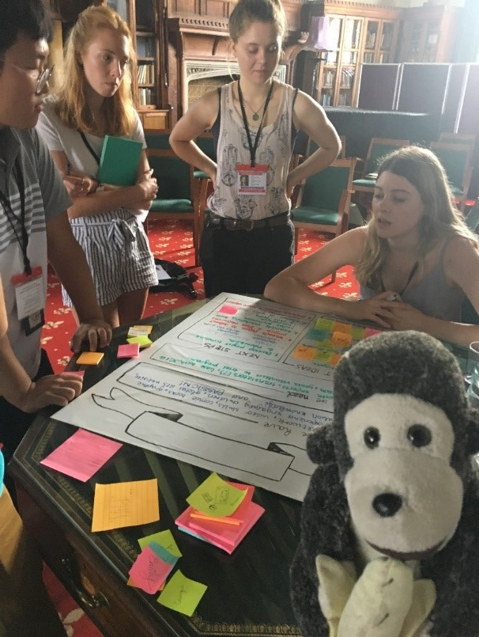

Slide 5

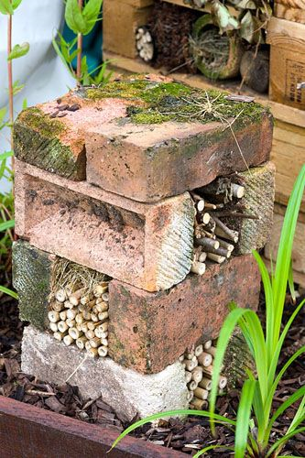
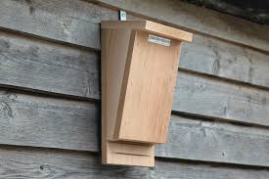
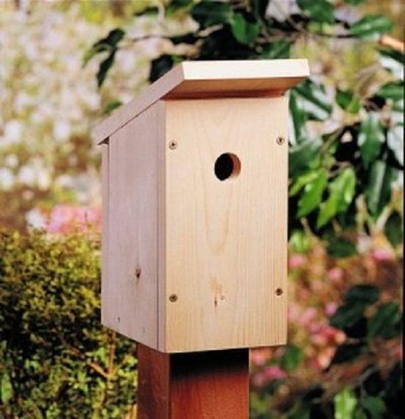
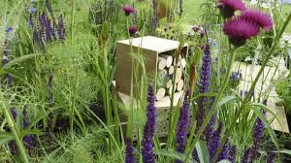

Slide 6
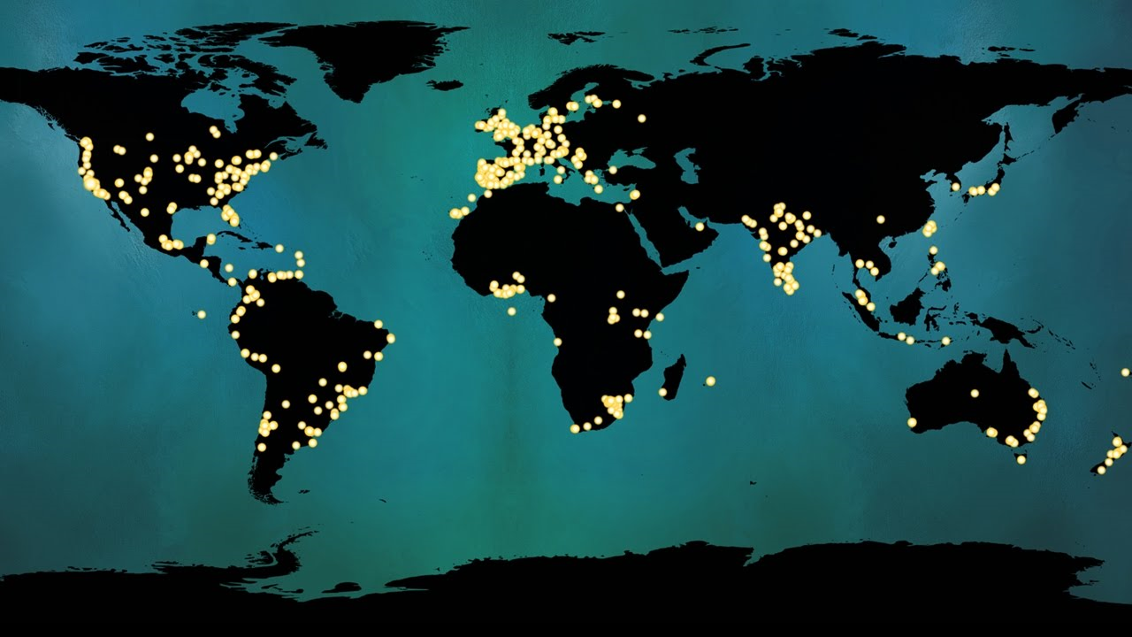
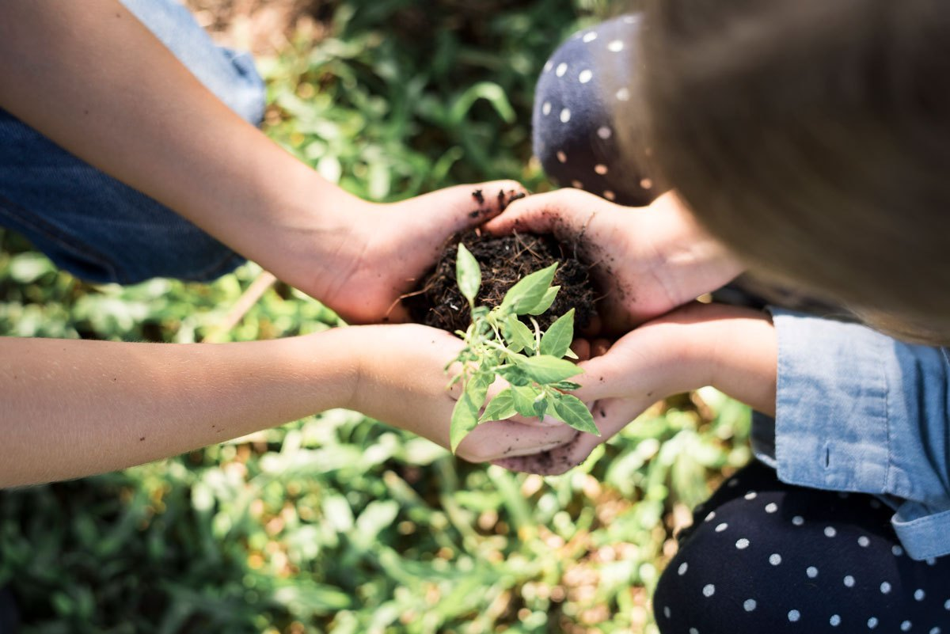
www.thejanegoodallinstitute.com

Slide 7
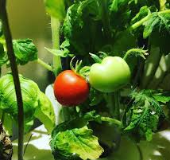
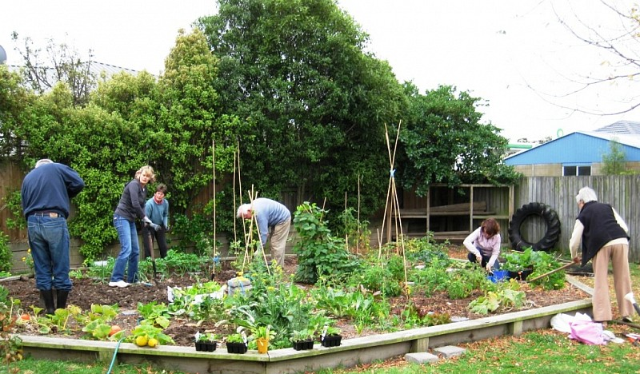

Notes:
Redcliff Community garden at: Ccga.org.nz

Slide 8
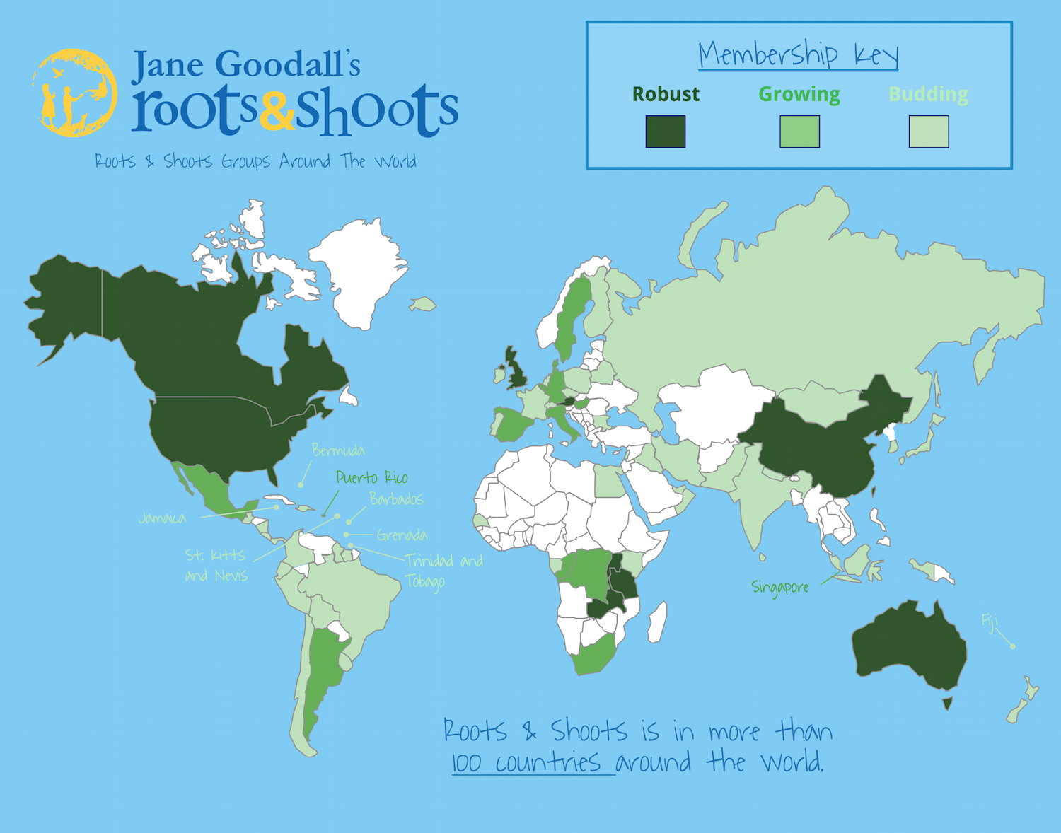
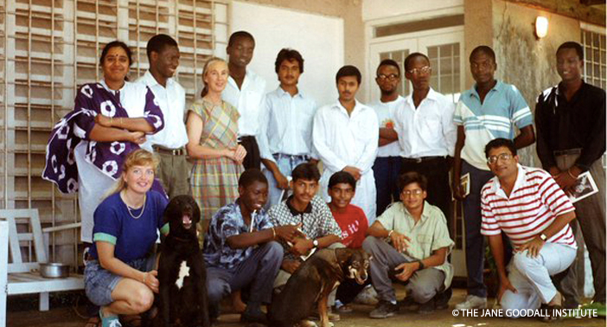

Slide 9

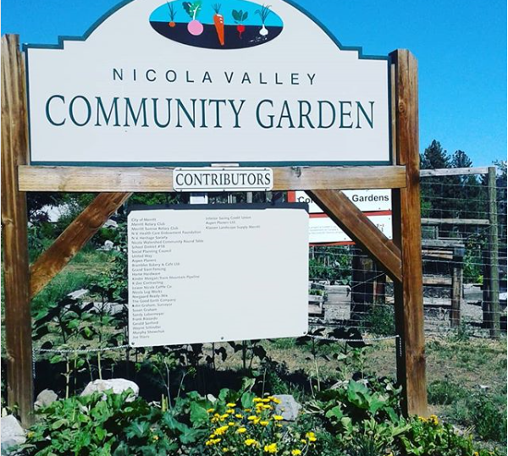
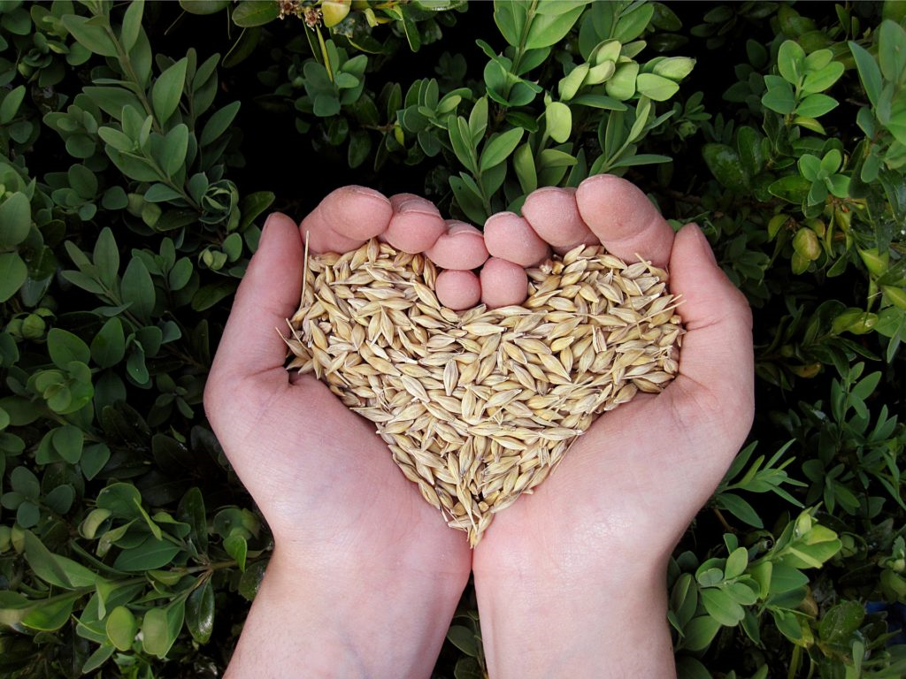
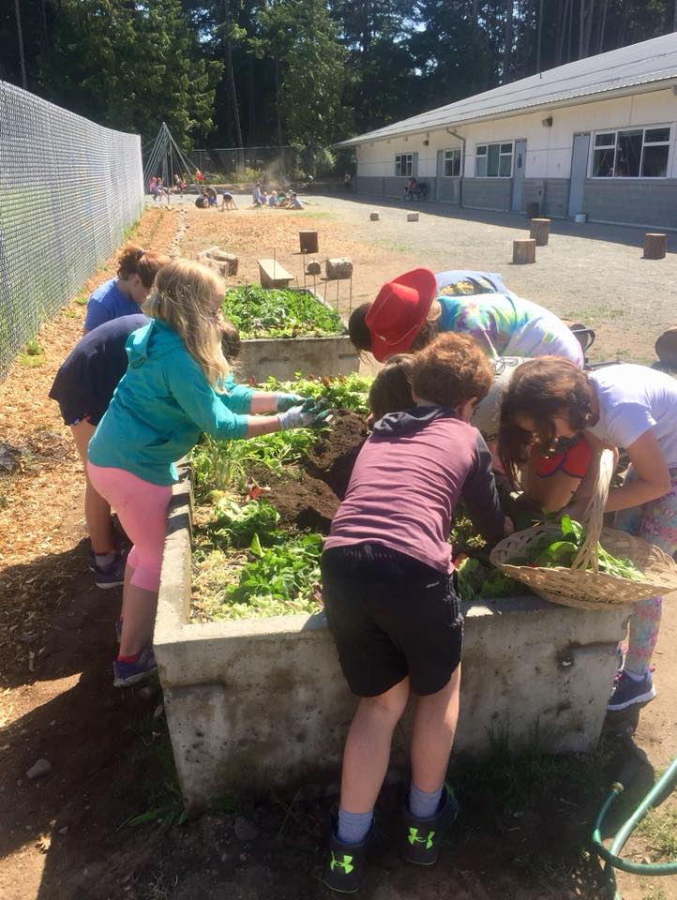
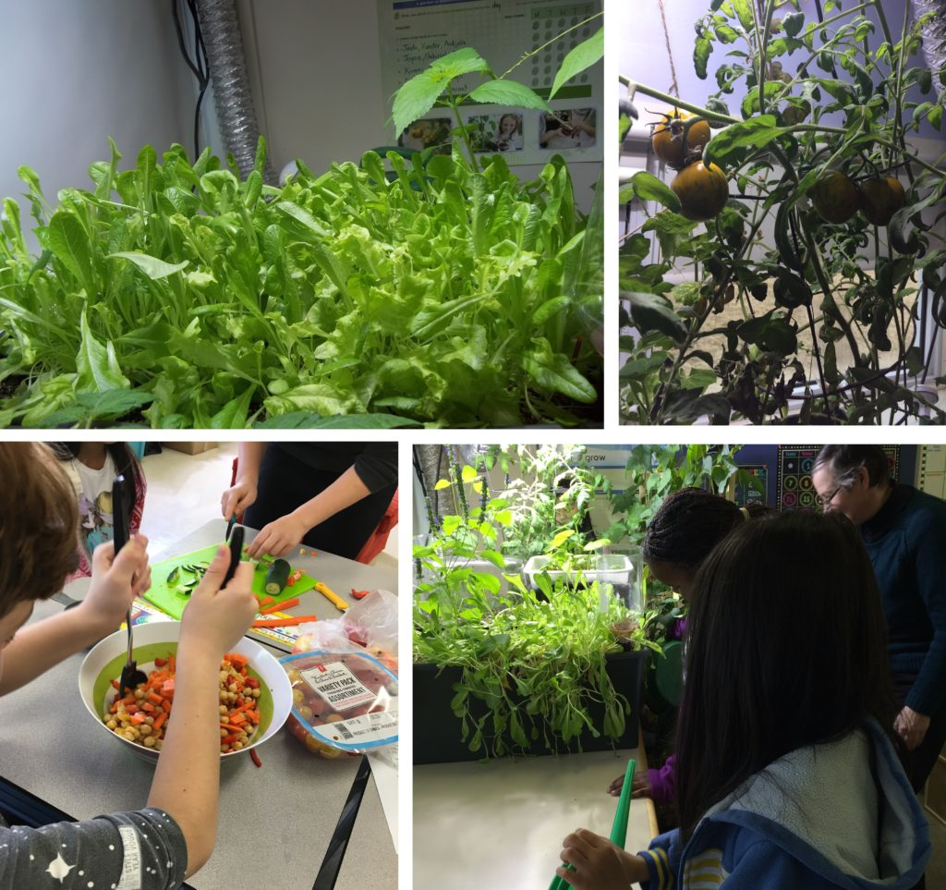
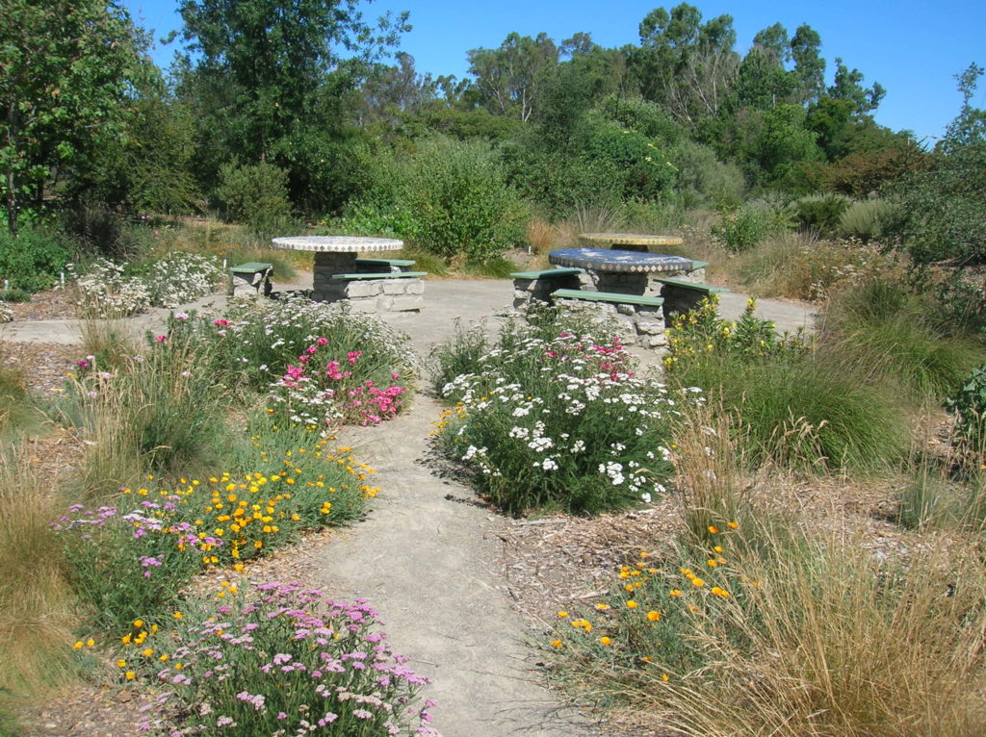
1
3
5
2
4

Slide 10

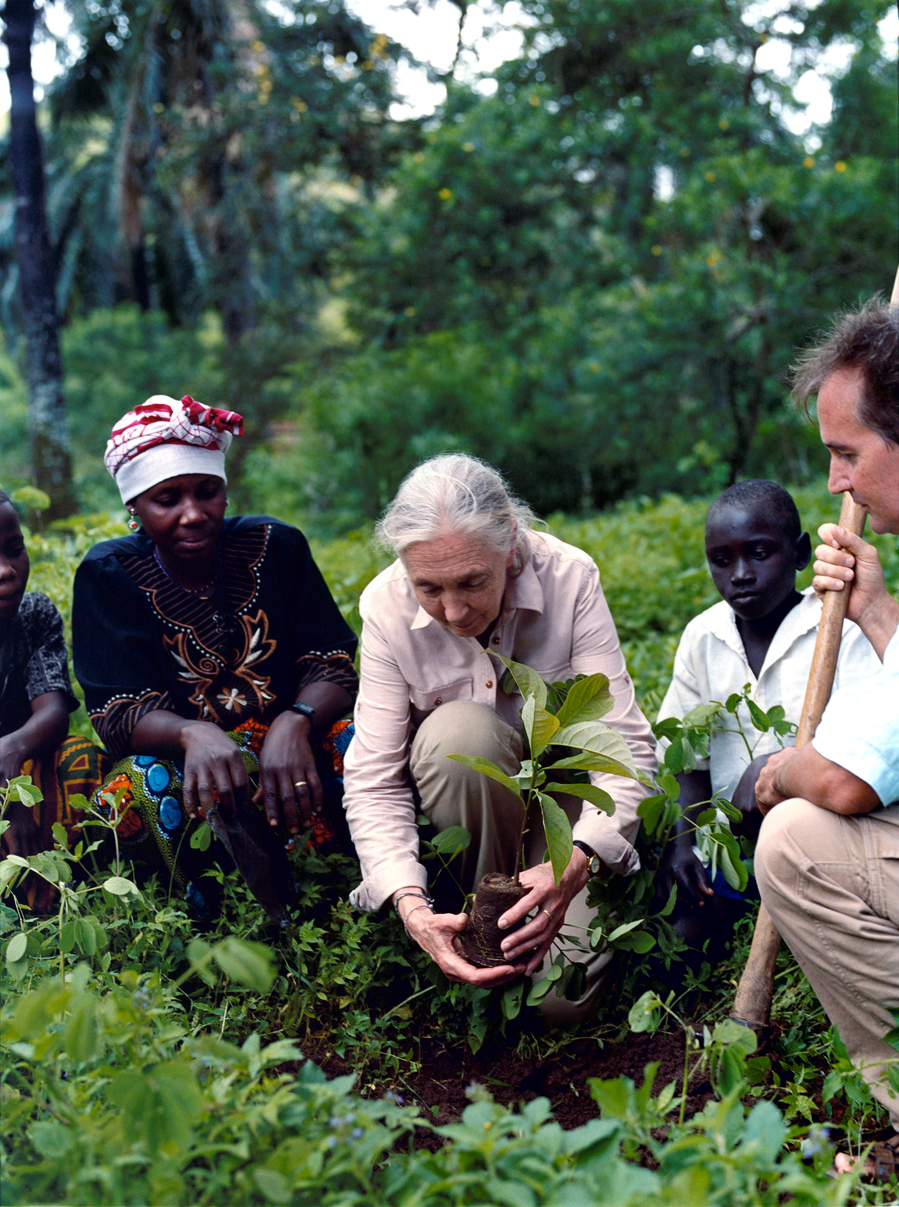
The Jane Goodall Institute of New Zealand (JGINZ):
www.janegoodall.org.nz
JGINZ Roots & Shoots:
www.janegoodall.org.nz/roots-shoots
JGINZ APE Fund:
www.janegoodall.org.nz/roots-shoots/ape-fund

